Slide 1
CHAPTER 3:
Statistical Description of Data
to accompany
Introduction to Business Statistics
seventh edition, by Ronald M. Weiers
Presentation by Priscilla Chaffe-Stengel
Donald N. Stengel
© 2011 Cengage Learning.
All Rights Reserved. May not be scanned, copied, or duplicated, or posted to a publicly accessible website, in whole or in part.

Slide 2
Chapter 3 - Learning Objectives
Describe data using measures of central tendency and dispersion:
  for a set of individual data values, and
  for a set of grouped data.
Convert data to standardized values.
Use the computer to visually represent data.
Use the coefficient of correlation to measure association between two quantitative variables.
© 2011 Cengage Learning.
All Rights Reserved. May not be scanned, copied, or duplicated, or posted to a publicly accessible website, in whole or in part.

Slide 3

Chapter 3 - Key Terms
Measures of Central Tendency,
The Center
Mean
  µ, population; , sample
Weighted Mean
Median
Mode
(Note comparison of mean, median, and mode)
© 2011 Cengage Learning.
All Rights Reserved. May not be scanned, copied, or duplicated, or posted to a publicly accessible website, in whole or in part.

Slide 4
Chapter 3 - Key Terms
Measures of Dispersion,
The Spread
Range
Mean absolute deviation
Variance
(Note the computational difference between σ² and s².)
Standard deviation
Interquartile range
Interquartile deviation
Coefficient of variation
© 2011 Cengage Learning.
All Rights Reserved. May not be scanned, copied, or duplicated, or posted to a publicly accessible website, in whole or in part.

Slide 5
Chapter 3 - Key Terms
Measures of Relative Position
Quantiles
  Quartiles
  Deciles
  Percentiles
Residuals
Standardized values
© 2011 Cengage Learning.
All Rights Reserved. May not be scanned, copied, or duplicated, or posted to a publicly accessible website, in whole or in part.

Slide 6
Chapter 3 - Key Terms
Measures of Association
Coefficient of correlation, r
  Direction of the relationship:
  direct (r > 0) or inverse (r < 0)
  Strength of the relationship:
  When r is close to 1 or –1, the linear relationship between x and y is strong. When r is close to 0, the linear relationship between x and y is weak. When r = 0, there is no linear relationship between x and y.
Coefficient of determination, r²
  The percent of total variation in y that is explained by variation in x.
© 2011 Cengage Learning.
All Rights Reserved. May not be scanned, copied, or duplicated, or posted to a publicly accessible website, in whole or in part.

Slide 7
The Center: Mean
Mean
  Arithmetic average = (sum all values)/# of values
    Population: µ = (Σx_{i})/N
    Sample: = (Σx_{i})/n
  Be sure you know how to get the values easily from your calculator and computer softwares.
Problem: Calculate the average number of truck shipments from the United States to five Canadian cities for the following data given in thousands of bags:
Montreal, 64.0; Ottawa, 15.0; Toronto, 285.0;
Vancouver, 228.0; Winnipeg, 45.0 (Ans: 127.4)
x
© 2011 Cengage Learning.
All Rights Reserved. May not be scanned, copied, or duplicated, or posted to a publicly accessible website, in whole or in part.

Slide 8
The Center: Weighted Mean
When what you have is grouped data, compute the mean using µ = (Σw_{i}x_{i})/Σw_{i}
Problem: Calculate the average profit from truck shipments, United States to Canada, for the following data given in thousands of bags and profits per thousand bags:
Montreal 64.0 Ottawa 15.0 Toronto 285.0
$15.00 $13.50 $15.50
Vancouver 228.0 Winnipeg 45.0
$12.00 $14.00
(Ans: $14.04 per thous. bags)
© 2011 Cengage Learning.
All Rights Reserved. May not be scanned, copied, or duplicated, or posted to a publicly accessible website, in whole or in part.

Slide 9
The Center: Median
To find the median:
1. Put the data in an array.
2A. If the data set has an ODD number of numbers, the median is the middle value.
2B. If the data set has an EVEN number of numbers, the median is the AVERAGE of the middle two values.
(Note that the median of an even set of data values is not necessarily a member of the set of values.)
The median is particularly useful if there are outliers in the data set, which otherwise tend to sway the value of an arithmetic mean.
© 2011 Cengage Learning.
All Rights Reserved. May not be scanned, copied, or duplicated, or posted to a publicly accessible website, in whole or in part.

Slide 10
The Center: Mode
The mode is the most frequent value.
While there is just one value for the mean and one value for the median, there may be more than one value for the mode of a data set.
The mode tends to be less frequently used than the mean or the median.
© 2011 Cengage Learning.
All Rights Reserved. May not be scanned, copied, or duplicated, or posted to a publicly accessible website, in whole or in part.

Slide 11
Comparing Measures of
Central Tendency
If mean = median = mode, the shape of the distribution is symmetric.
If mode < median < mean or if mean > median > mode,
the shape of the distribution trails to the right,
is positively skewed.
If mean < median < mode or if mode > median > mean,
the shape of the distribution trails to the left,
is negatively skewed.
© 2011 Cengage Learning.
All Rights Reserved. May not be scanned, copied, or duplicated, or posted to a publicly accessible website, in whole or in part.

Slide 12
The Spread: Range
The range is the distance between the smallest and the largest data value in the set.
Range = largest value – smallest value
Sometimes range is reported as an interval, anchored between the smallest and largest data value, rather than the actual width of that interval.
© 2011 Cengage Learning.
All Rights Reserved. May not be scanned, copied, or duplicated, or posted to a publicly accessible website, in whole or in part.

Slide 13
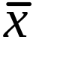
Key Concept - Residuals
Residuals are the differences between each data value in the set and the group mean:
  for a population, x_{i} – µ
  for a sample, x_{i} –
© 2011 Cengage Learning.
All Rights Reserved. May not be scanned, copied, or duplicated, or posted to a publicly accessible website, in whole or in part.

Slide 14

The Spread: MAD
The mean absolute deviation is found by summing the absolute values of all residuals and dividing by the number of values in the set:
for a population, MAD = (Σ|x_{i} – µ|)/N
for a sample, MAD = (Σ|x_{i} – |)/n
© 2011 Cengage Learning.
All Rights Reserved. May not be scanned, copied, or duplicated, or posted to a publicly accessible website, in whole or in part.

Slide 15
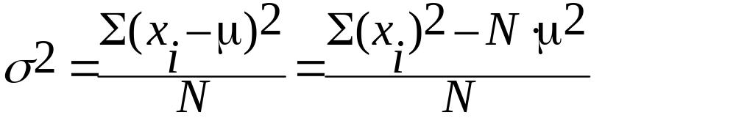
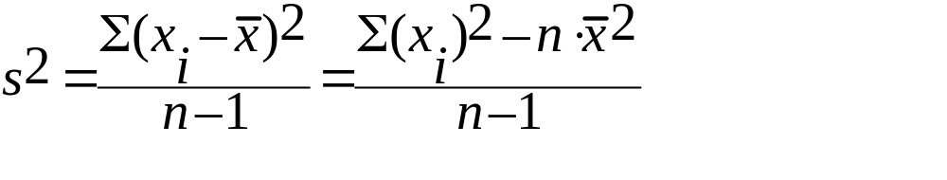
The Spread: Variance
Variance is one of the most frequently used measures of spread,
  for population,
  for sample,
The right side of each equation is often used as a computational shortcut.
© 2011 Cengage Learning.
All Rights Reserved. May not be scanned, copied, or duplicated, or posted to a publicly accessible website, in whole or in part.

Slide 16
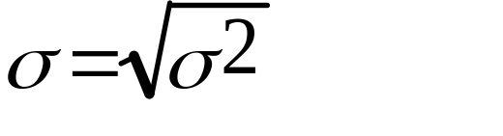
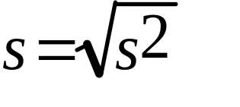
The Spread: Standard Deviation
Since variance is given in squared units, we often find uses for the standard deviation, which is the square root of variance:
  for a population,
  for a sample,
Be sure you know how to get the values easily from your calculator and computer softwares.
© 2011 Cengage Learning.
All Rights Reserved. May not be scanned, copied, or duplicated, or posted to a publicly accessible website, in whole or in part.

Slide 17
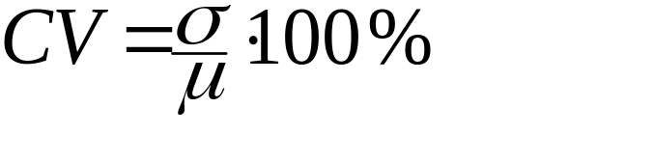
Coefficient of Variation
The coefficient of variation (CV) expresses the standard deviation as a percent of the mean, indicating the relative amount of dispersion in the data.
© 2011 Cengage Learning.
All Rights Reserved. May not be scanned, copied, or duplicated, or posted to a publicly accessible website, in whole or in part.

Slide 18
Relative Position - Quartiles
One of the most frequently used quantiles is the quartile.
Quartiles divide the values of a data set into four subsets of equal size, each comprising 25% of the observations.
To find the first, second, and third quartiles:
  1. Arrange the N data values from smallest to largest.
  2. First quartile, Q₁ = data value at position (N + 1)/4
  3. Second quartile, Q₂ = data value at position 2(N + 1)/4
  4. Third quartile, Q₃ = data value at position 3(N + 1)/4
© 2011 Cengage Learning.
All Rights Reserved. May not be scanned, copied, or duplicated, or posted to a publicly accessible website, in whole or in part.

Slide 19
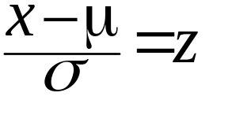
What is a Standardized Value?
How far above or below the individual value is compared to the population mean in units of standard deviation
  “How far above or below”= (data value – mean)
  which is the residual...
  “In units of standard deviation” = divided by σ
Standardized data value
  A negative z means the data value falls below the mean.
© 2011 Cengage Learning.
All Rights Reserved. May not be scanned, copied, or duplicated, or posted to a publicly accessible website, in whole or in part.

Slide 20
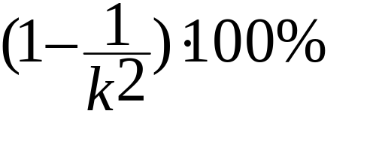
Why is a Standardized Value Important?
Chebyshev’s Theorem: Regardless of the shape of a distribution, for either a sample or the population, the percentage of observations that fall within k (for k > 1) standard deviations of the mean will be at least
© 2011 Cengage Learning.
All Rights Reserved. May not be scanned, copied, or duplicated, or posted to a publicly accessible website, in whole or in part.

Slide 21
Why is a Standardized Value Important?
The Empirical Rule:
For bell-shaped, symmetric distributions,
  about 68% of the observations will fall within 1 standard deviation of the mean,
  about 95% of the observations will fall within 2 standard deviations of the mean,
  practically all of the observations will fall within 3 standard deviations of the mean.
© 2011 Cengage Learning.
All Rights Reserved. May not be scanned, copied, or duplicated, or posted to a publicly accessible website, in whole or in part.

Slide 22
An Example: Problem 3.60
A law enforcement agency administering breathalyzer tests to a sample of drivers stopped at a New Year’s Eve roadblock measured the following blood alcohol levels for the 25 drivers who were stopped:
0.00% 0.08% 0.15% 0.18% 0.02%
0.04% 0.00 % 0.03 % 0.11 % 0.17%
0.05 % 0.21 % 0.01 % 0.10 % 0.19 %
0.00 % 0.09 % 0.05 % 0.03 % 0.00 %
0.03 % 0.00 % 0.16 % 0.04 % 0.10 %
© 2011 Cengage Learning.
All Rights Reserved. May not be scanned, copied, or duplicated, or posted to a publicly accessible website, in whole or in part.

Slide 23
Problem 3.60, continued
Calculate the mean and standard deviation from this sample.
Ans: Mean = 0.0736%
Standard Deviation = 0.0684%
© 2011 Cengage Learning.
All Rights Reserved. May not be scanned, copied, or duplicated, or posted to a publicly accessible website, in whole or in part.

Slide 24
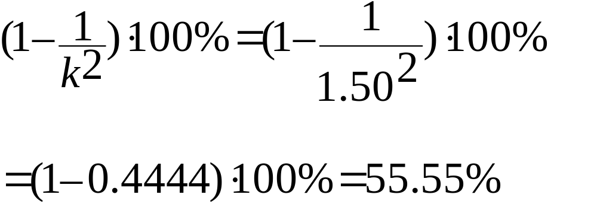
Problem 3.60, continued
Use Chebyshev’s Theorem to determine the minimum percentage of observations that should fall within k = 1.50 units of standard deviation from the mean.
Ans:
At least 55.55% of the data values should fall within k = 1.50 units of standard deviation from the mean.
© 2011 Cengage Learning.
All Rights Reserved. May not be scanned, copied, or duplicated, or posted to a publicly accessible website, in whole or in part.

Slide 25
Problem 3.60, continued
Do the sample results support Chebyshev’s Theorem?
Ans: 1.50 (s) = 0.1026%
mean + 1.50 (s) = 0.0736% + 0.1026%
= 0.1762%
mean – 1.50 (s) = 0.0736% – 0.1026%
= – 0.0290%
A total of 22/25 data values fall in this interval, or 88% of the sample. Yes, the data support Chebyshev’s Theorem.
© 2011 Cengage Learning.
All Rights Reserved. May not be scanned, copied, or duplicated, or posted to a publicly accessible website, in whole or in part.

Slide 26
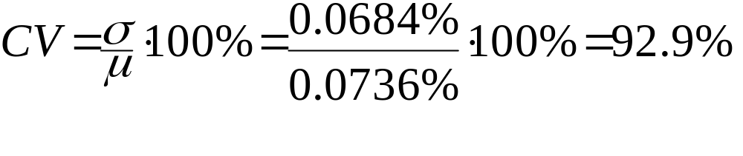
Problem 3.60, continued
Calculate the coefficient of variation for these data.
Ans:
© 2011 Cengage Learning.
All Rights Reserved. May not be scanned, copied, or duplicated, or posted to a publicly accessible website, in whole or in part.

